Slide 1
Department of Campus Safety
“Tell Me About Campus Safety”

Slide 2
D’Youville University Campus Safety Department
CURRENT:
D’Youville expanded it’s Department of Campus Safety in 2018, by establishing it’s own official Department of Campus Safety (DCS) with the first in-house hiring.
The new Department is a Hybrid model like many of other Universities. This is a more professional model with a D’Youville University employee as the Administrative Director and Operational Chief.

Slide 3
HISTORY
In the 1980’s DYU began contracting security coverage and is currently contracting with Allied Universal as the University’s Campus Safety provider for Officers, training and licensing.
Allied Universal (Legacy US Security Associates) is the largest security company in Western New York.
Allied Universal provides thorough background checks, drug screening, inspection spot checks, and 24/7 monitoring for DYU and all its clients.

Slide 4
OVERVIEW
D’Youville Campus Safety falls under the Operations Department.
The Director of Campus Safety meets weekly with the Operations team and bi-weekly with the Associate Vice President (AVP) of Operations.
The Director of Campus Safety is an active member of numerous committees such as the Emergency Planning Committee, Clery Collaboration Team, Threat Assessment Team as well as other Administrative key committees to keep the campus safe.

Slide 5
OVERVIEW
D’Youville University continues year after year to have one of, if not the, lowest incident rates and severity of crime on campus of all Western New York Colleges and Universities**. This is an achievement to be proud of.
** Data Reference: US Department of Education. “Campus Safety & Security Survey” https://ope.ed.gov/campussafety/#/

Slide 6
WHO WE ARE
The Campus Safety Department at D’Youville University consists of approximately 25 full and part-time unarmed Officers.
The Chief of DYU Campus Safety Department has over 27 years in Federal Law Enforcement and Private Security/Public Safety experience.

Slide 7
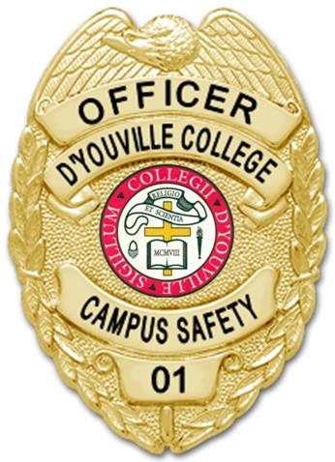
WHO WE ARE
D'Youville University’s Campus Safety Department is a 24/7/365 operation that is comprised of Officers who are highly trained and extremely knowledgeable of the urban DYU campus environment.
The Campus Safety Department is headed by the Director of Campus Safety who oversees an Officers staff, acting as the operational Chief.
Chief Bova oversees the Captain, Lieutenants, Sergeants and the Officer Corps.

Slide 8
RESPONSIBILITIES/ SERVICES
Campus Safety should be contacted anytime criminal activity is witnessed or suspected.
“If You See Something, Say something”
Access Control: Campus Safety is in charge of the Campus-wide access control system for all external and internal swipe reader controlled doors. Campus ID cards are used as your “keys to the college” and are programmed accordingly for required access.
Alarm Response: Officers respond to all campus alarms such as fire, burglar, window and panic alarms. In all cases of criminal activity on campus Officers will take action within the scope of the law in addition to calling local Law Enforcment- Buffalo Police.

Slide 9
RESPONSIBILITIES/ SERVICES (cont.)
Patrols: “Detect, deter, and report” is the mantra of any on-site Campus Safety staff. At DYU, Officers constantly patrol the campus via marked patrol vehicles, tactical bike patrol units, and foot patrols (inside & outside).
Multiple Officers are committed to patrol the campus 24 hrs/day providing the much needed visibility and vigilance to deter criminal activity and keeping the campus safe.

Slide 10
RESPONSIBILITIES/ SERVICES (cont.)
SAFETY Escorts: Campus Safety will escort students, staff, and guests throughout the campus and to nearby residences* 24/7.
*Within 2 block range
Call 716-829-7550 to request a Safety Escort anytime.**
**Please allow 5-10 minutes before needed departure.

Slide 11
RESPONSIBILITIES/ SERVICES (cont.)
Parking Enforcement
DYU and Campus Safety Maintains order and safety on campus by enforcing the University’s policies regarding parking on campus.
DYU Campus Safety Department is trained by the City of Buffalo Parking Enforcement and can issue City of Buffalo tickets for violations.

Slide 12
RESPONSIBILITIES/ SERVICES (cont.)
Investigations: Campus Safety investigates all criminal and non-criminal incidents, and in some instances can/will make arrests as allowed per law, in addition to relying on the Buffalo Police response as well.
Emergency Response: The Campus Safety staff responds to all incidents requiring emergency services (police, fire, and medical) and directs them to the scene and assists as needed.

Slide 13
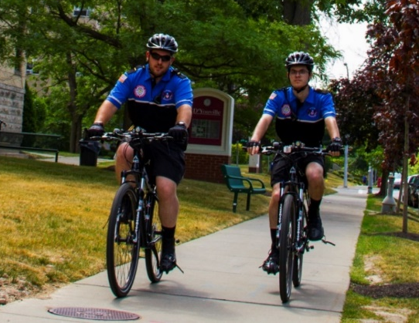
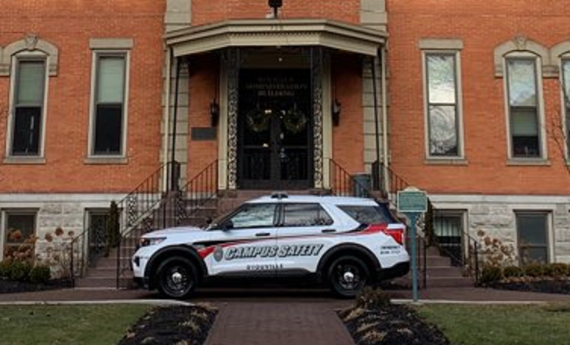
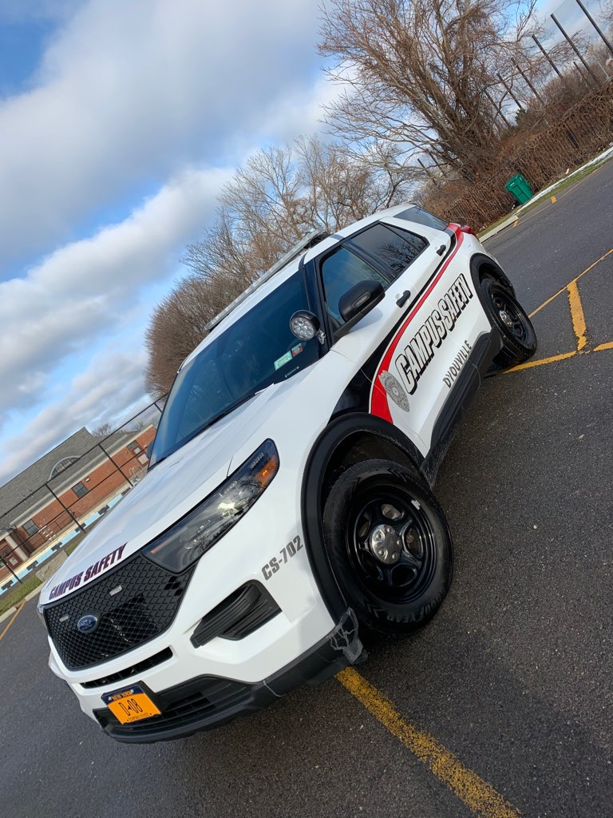
ON PATROL
Campus Safety provides a continual campus patrol (indoor and outside) 24 hours per day. All Patrol Officers are equipped with Law Enforcement caliber, encrypted Motorola radios for effective communications.
Officers patrol in vehicles, bikes and on foot. Together our patrols have built a good rapport with the surrounding community and neighbors of D’Youville.

Slide 14
ON PATROL
Officers patrol D’Youville’s urban campus, including all on-campus parking lots, surrounding perimeter streets, campus access areas, and all campus buildings.
Supervisory Officers trained on a modified Emergency Vehicle Operation Course (EVOC) are patrolling 24/7 in multiple marked Campus Safety Vehicles

Slide 15
SURVEILLANCE
In addition to active roving patrols, DYU Campus Safety utilizes and monitors over 140 advanced digital video cameras that cover the entire campus.
Campus Safety has the capability to control the PTZ cameras (pan, tilt and zoom) when needed and review previously recorded video footage when necessary.

Slide 16
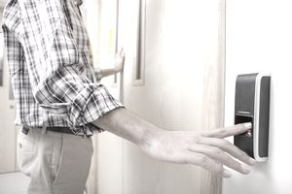
ACCESS CONTROL
Campus Safety oversees the Access Control System (swipe-card readers) at D’Youville and programs everyone’s DYU Campus ID cards with appropriate access for external building doors and applicable indoors areas access control is needed.
Campus Safety also monitors key video intercom systems at multiple buildings on campus 24/7:

Slide 17
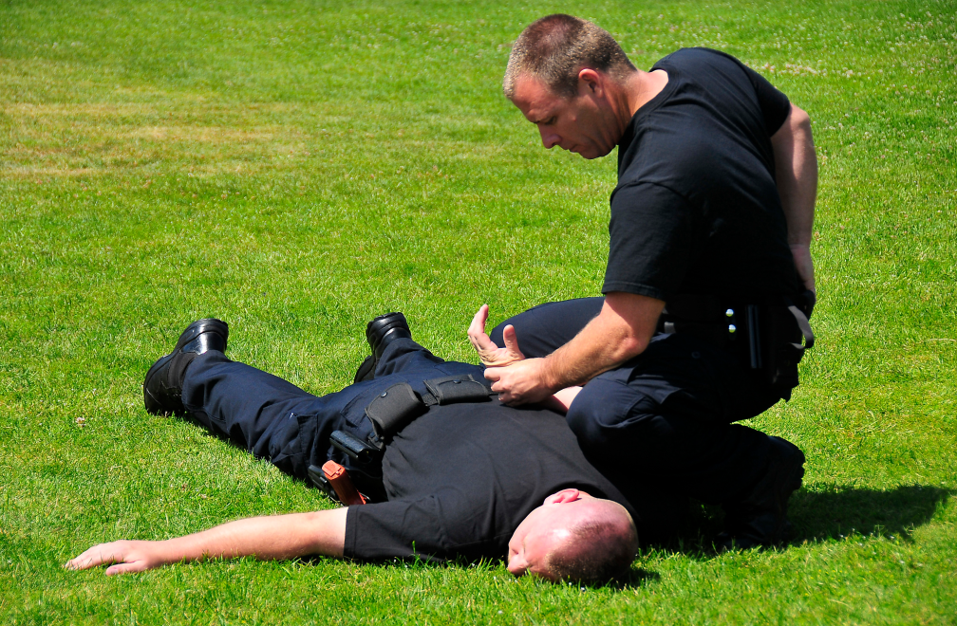
TRAINING
Training is provided through a number of different sources, including Allied Universal, the NYS Division of Criminal Justice Services (NY DCJS), Erie County Central Police Services/Erie County Law Enforcement Academy and other supportive Law Enforcement agencies in the Western New York area.

Slide 18
TRAINING
To work as a Campus Safety Officer at DYU an applicant must pass a series of criminal background checks: locally, statewide (conducted by NYS Department of Criminal Justice Services), and nationally (FBI fingerprint analysis).

Slide 19
TRAINING
Officers must also pass a comprehensive drug screening test administered by an outside agency. The staff is then tested in random fashion at least once annually. Once completed, the applicant must become NYS certified as a license NYS security guard.
This entails 24 hours of in-class training by a state certified instructor in which he must pass standardized exams followed by an additional 24 hrs in-house DYU training program by the Field Training Officer (FTO).

Slide 20
TRAINING
A two year NYS Security Guard license issued after the completion of an 8 hour annual recertification class. This initial training consists of the duties and functions of security, access control, emergency response, communication, and conduct.
Lieutenants & Sergeants are trained by the Erie County Law Enforcement Academy through Allied Universal and are certified to carry handcuffs, and OC Spray.

Slide 21
MORE TRAINING
The DYU Campus Safety Officer must then complete extensive on-the-job training at DYU and a ninety day probationary period before he becomes a permanent member of the Department.
Mandatory training classes are conducted year round to continually enhance the staff’s knowledge and performance. These consist of every facet of security work, concentrating on specific Campus Safety issues.
100% of the staff is certified CPR-AED/First Aid with the course offered twice annually.

Slide 22
“IF YOU SEE SOMETHING SAY SOMETHING!” ….. and we will do something”
As adopted from Homeland Security, D’Youville Campus Safety Department advises: “If You See Something, Say something”.
Hence, if you observe a crime, suspicious activity, or you’re reporting an emergency on or around campus please contact the main Campus Safety Dispatch Desk and follow their directives. 716-829-7550, or Emergency Line: 716-829-7777. We will respond!

Slide 23
COMMUNITY RELATIONS
D’Youville Campus Safety Department has established strong working relationships with local law enforcement and emergency responders, including the Buffalo Police and Buffalo Fire Departments.

Slide 24
COMMUNITY RELATIONS
In addition to these key partners, we also maintain an active and positive communications with our neighbors through participation in the Community & Block Club Associations and the Police Community Outreach Committees.
Effective partnerships enable the DYU Campus Safety Department to keep our campus safe and secure.

Slide 25
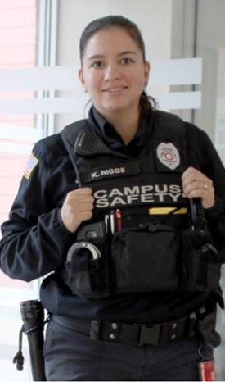
DEPARTMENT SPECIFICS
2022 COMMAND STRUCTURE
Chief Keith J. Bova; xt 7550
Captain Greg Mikosz; xt 7550
Lieutenants/Shift Supervisors; xt 7550
Sergeants FTOs/SRROs: xt7550
Campus Safety Officer Staff
Student Safety Assistants
(Includes Student Employment & Federal Work Study*)
* Students can apply to work for Campus Safety through Student Solutions/Career Services

Slide 26
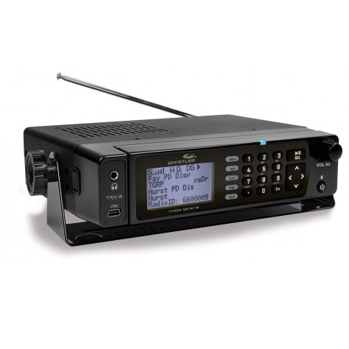
CAMPUS SAFETY DEPARTMENT KEY FEATURE
Buffalo Police & Fire Scanners are used daily by Campus Safety Department to monitor Law Enforcement & Fire activity in the surrounding area! We’re listening.

Slide 27
CAMPUS SAFETY DEPARTMENT KEY FEATURE
Although all external campus doors are always locked 24/7 and are accessed only through authorized entry, DYU also has invested in a “One-Button” Campus-wide external door lockdown system
The “one-button” lockdown is operated and controlled by Campus Safety for use/activation during critical emergencies or for precautionary measures.

Slide 28
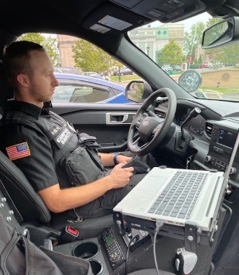
CAMPUS SAFETY ROAD PATROL “TO PROTECT AND SERVE”
D'Youville’s Vehicle Patrol Unit is a great tool utilized by the Campus Safety Department.
The marked vehicle patrols operate 24/7/365 in and around the campus community.
Experienced Lieutenant-level Officers have been trained on Safe Vehicle Operations courses, and a specially designed Erie County Law Enforcement Academy- “Campus Safety Emergency Vehicle Operations Course” (CSEVOC).

Slide 29
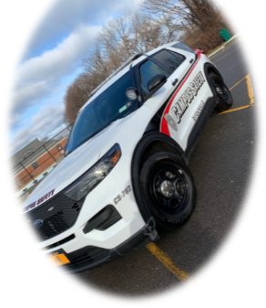
CAMPUS SAFETY ROAD PATROL - “TO PROTECT AND SERVE”
The DYU vehicle patrols are specialized to meet the needs of the DYU community with the ideal tools to get the Campus Safety job done .

Slide 30
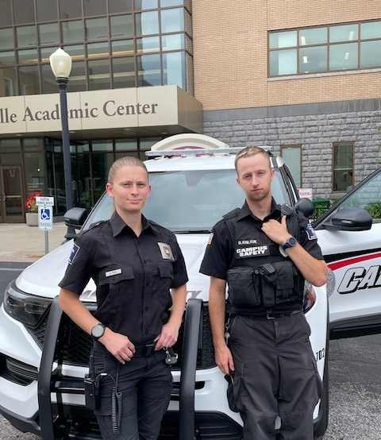
CAMPUS SAFETY ROAD PATROL - “TO PROTECT AND SERVE”
Our vehicles are equipped with first-responder kits, mobile AEDs, roadside emergency and assistance tools for handling any condition and situation to help anyone in need– student, staff, faculty or community neighbor.

Slide 31
CAMPUS SAFETY ROAD PATROL
The marked patrol vehicle is a strong deterrent for any potential wrong doing in the findings its way onto the campus. D’Youville’s Police interceptor Utility vehicle is fully equipped to provide high visibility while providing unparalleled vigilance for the safety and security of the D’Youville campus and surrounding community.

Slide 32
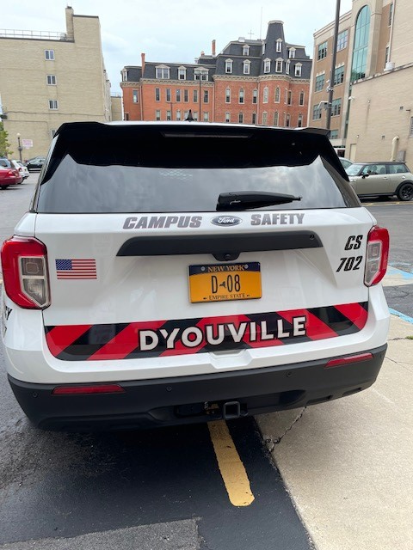
CAMPUS SAFETY ROAD PATROL
The vehicle patrol is a tactical response unit that is fully outfitted to be able to respond quickly to any incident in and around campus with high visibility and a fast response time.
Within the patrol jurisdiction acting within parameters of applicable laws, certified Officers are able to maintain order and enforce College polices and laws when necessary.

Slide 33
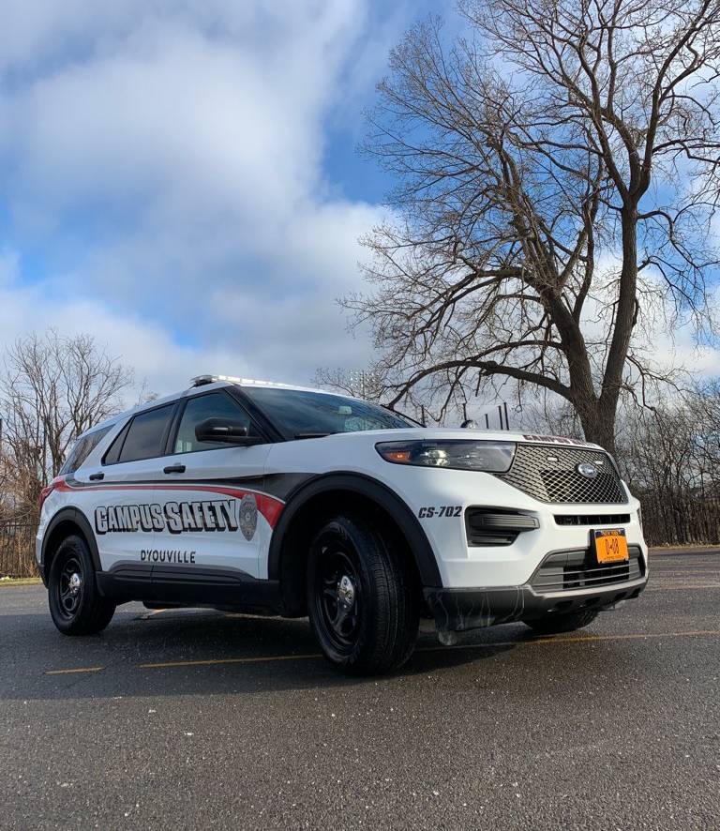
CAMPUS SAFETY ROAD PATROL
The patrol unit works hand in hand with the Buffalo Police on a variety of service calls in the area on or near the D’Youville campus. Providing this support not only establish good working relationships with other First Responders but it services the West Side area in which D’Youville is integrated in.

Slide 34
CAMPUS SAFETY ROAD PATROL- FORD TELEMATICS
Every new Ford Police Interceptor Utility comes with a built-in Ford modem and for working with the new Ford Telematics system* Fuel savings, CO2 emissions, vehicle health and more – this simple-to-use yet powerful tool delivers manufacturer-grade information, insights and solutions right to your fingertips.

Slide 35
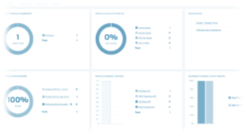
CAMPUS SAFETY ROAD PATROL- FORD TELEMATICS
Through Ford Telematics, DYU Campus Safety can monitor patrol fleet with GPS tracking and geofencing, get live vehicle health alerts to plan and limit downtime, set reminders for vehicle service, analyze driver behavior, and help manage fuel usage to potentially reduce costs

Slide 36
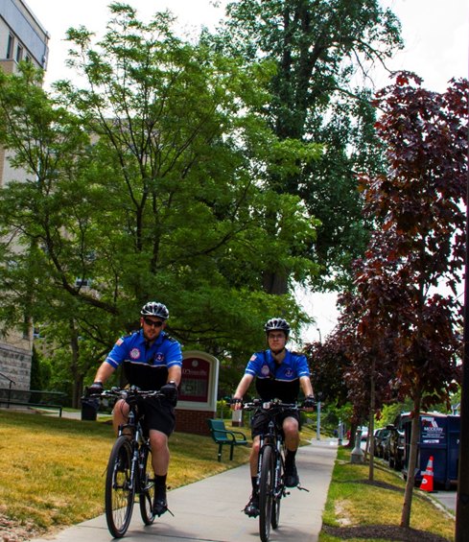
CAMPUS SAFETY BIKE PATROL
Campus Safety Department utilizes a tactical Bike Patrol Unit.
Used Heavily as a tactical unit and a big deterrent against crime in area.

Slide 37
CAMPUS SAFETY BIKE PATROL
Bike Officers complete a rigorous 32 hour Police course sanctioned by the International Police Mountain Bike Association, which was taught by UB Police through Erie County Law Enforcement Academy

Slide 38
CAMPUS SAFETY BIKE PATROL
Other Police Agencies in Buffalo area take the same course. D’Youville had 4 Officers in the inaugural graduating class on June 20, 2016

Slide 39
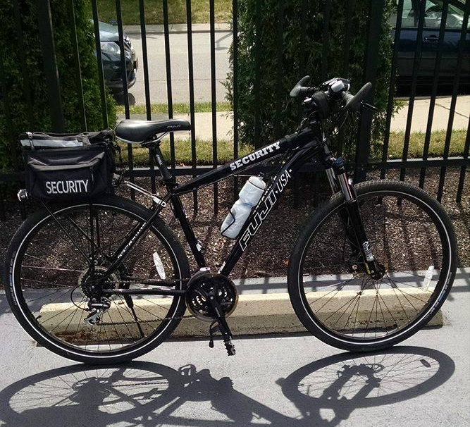
CAMPUS SAFETY BIKE PATROL
Bike are fully equipped heavy duty Police Bikes with lights, sirens, First Aid gear, and wireless equipment!

Slide 40
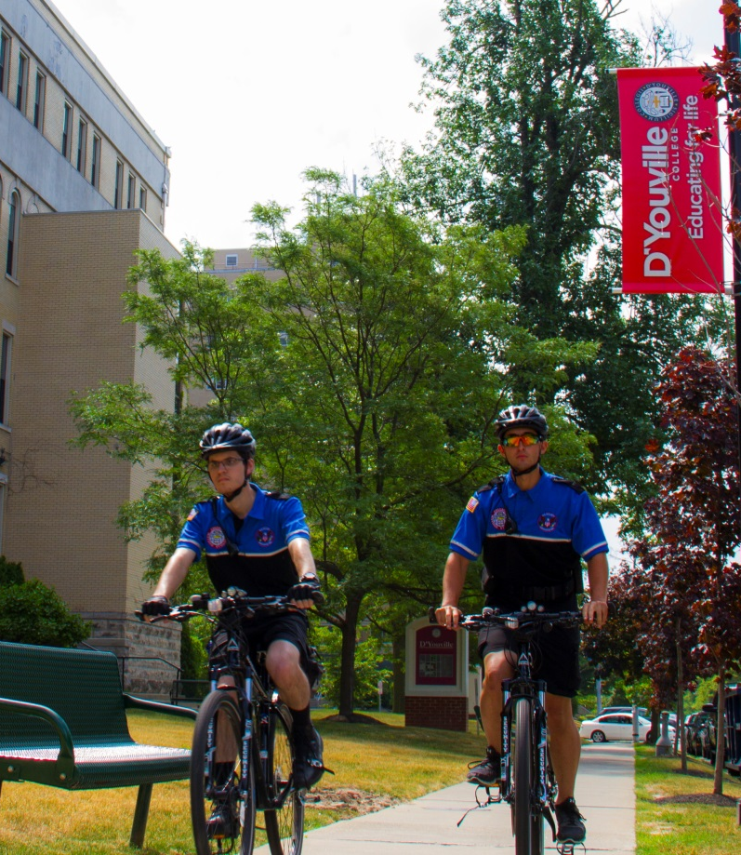
CAMPUS SAFETY BIKE PATROL
Bikes are on patrol between 8am-6 pm daily
BP responds quick, sees more, deters more and covers more area..

Slide 41
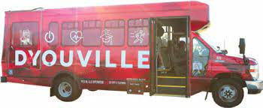
THE REDBUS
Want to stay warm and get door-to-door service to get to your classes? Look no further than the DYU RedBus
DYU Campus Safety spearheaded the planning of, and oversees the D’Youville University Campus Shuttle called “RedBus”
D'Youville's free shuttle service operates 7a-7p M-F, when the college is open, and helps students commute from free parking lots and travel throughout our compact campus.
Your D'Youville ID is all you will need to catch a lift on the “RedBus”.

Slide 42
THE REDBUS
FEATURES
Designated stops throughout the D'Youville campus.
Times and shuttle tracking available in the ‌RedBus Tracker
Free service to the entire D'Youville community — just show your DYU ID.
RedBus transportation began operations in 2019.
RedBus operates 7a-7p Monday-Friday (when University is open)

Slide 45
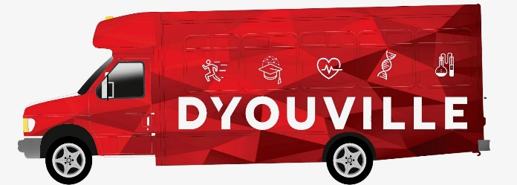
THE REDBUS
SHAREPOINT LINKS
Red-Bus-Poster.pdf
Shuttle-Stop-Info[1].pdf

